Slide 1

Password Manager
Enhancing Security and Usability

Slide 2
Objective and Introduction:
Develop a user-friendly password manager for enhanced security and streamlined password management.
In an era dominated by digital technology and online interactions, secure access to personal information is paramount.
Passwords play a pivotal role as the primary guardians of our online identities and data.

Slide 3
Scope of the Study:
Primarily focused on developing a password manager application using Python and tkinter.
Emphasis on usability and basic security measures.
Excluded advanced security practices, extensive cross-platform compatibility testing, and in-depth database management.
Acknowledged constraints in balancing usability with security during development.

Slide 4

Research Methodology:
Programming Language and Libraries:
Developed using Python, known for its versatility and readability.
Utilized the tkinter library for building a cross-platform compatible graphical user interface (GUI).
User Interface Design:
Designed a clean and straightforward GUI with elements such as labels, entry fields, and buttons.
Prioritized ease of use with clear labels and user instructions.
Password Storage and Retrieval Logic:
Passwords stored in memory as a database file using SQLite, providing quick and efficient retrieval.
Implemented a random character generation technique for creating strong and unique passwords.
Security Considerations:
Passwords not displayed in plain text; revealed only when explicitly requested.
Introduced a passcode system for an additional layer of security.
Acknowledged the use of a dummy database for educational purposes, emphasizing the need for real-world security measures.

Slide 5
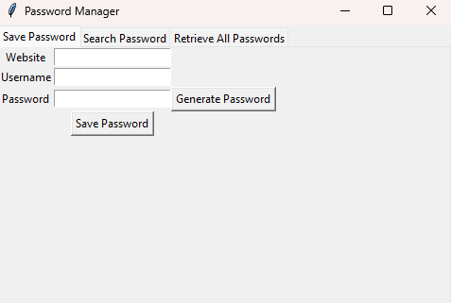
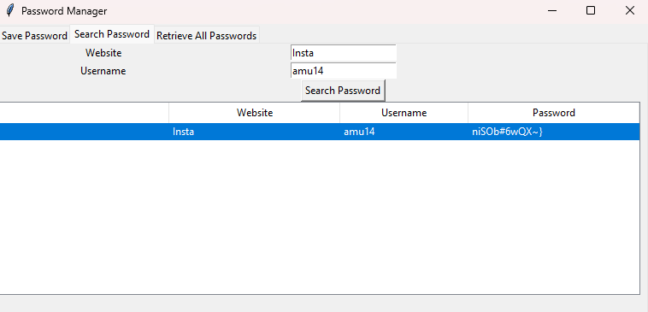
Results:
1. Usability Assessment
Built-in GUI design for easy navigation.
Streamlined process for saving, retrieving, and generating passwords.

Slide 6
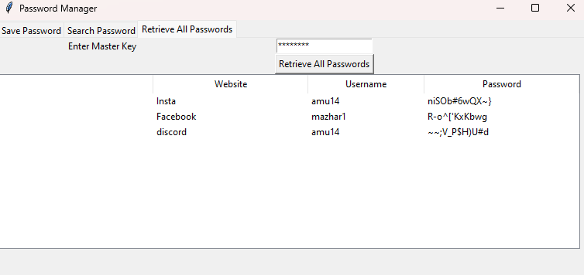
2. Security Evaluation:
Passcode system for Retrieval of all Password control With Master Key.

Slide 7
Limitations of the Application:
Passcode Reliance:
While the passcode system adds a layer of protection, it introduces a potential single point of failure.
An incorrect passcode can lead to the loss of access to stored credentials, potentially frustrating users.
Dummy Database Usage:
The application employs a dummy database for educational purposes.
This simplification, while aiding development, falls short in terms of robust data security.

Slide 8

Conclusions:
Significance in Cybersecurity:
Essential Role: Password managers play a vital role in modern cybersecurity.
Solving Challenges: They address password complexity, uniqueness, and management issues.
Reducing Risks: A practical solution to minimize security breaches and identity theft.
Closing Remarks and Future Exploration:
Emphasis on Progress: Stress the continual need for exploration in password manager development.
Elevating Security: Future iterations can improve security, extend compatibility, and introduce features like biometric authentication and cloud storage.
Action Needed: Encourage researchers to prioritize security, usability, and user education for the evolving digital landscape.

Slide 9
Thank You:

